Slide 1
Affordable Connectivity Program
The What, Why & How

Slide 2
TABLE OF CONTENTS
01
02
03
04
Introduction
Eligibility
What is ACP?
What are the benefits?
Defining “Household,” Government Benefits, & Enrollment Through School
Applying
FAQ
Quick tips for successfully signing up for benefits!
Insider Knowledge, Resources, & More!

Slide 4
01
ACP 101
Learning the fundamentals of the Affordable Connectivity Program!

Slide 5
The ACP is a program of the Federal Communications Commission (FCC) and is a $14.2 billion program to help individuals who cannot afford the cost of home broadband. Its aim is to address the Broadband Affordability Gap present in the United States.
About 51.6 million households are eligible, and this could include you!

Slide 6
Detailing the Benefits
Note: Providers might only participate in one of these services!
Internet Service Reduction
Discounted Device
Covers up to $30 on selected internet service providers, or $75 on qualifying Tribal Lands
Can be applied to any current or new participating internet provider
One-time, $100 discount for any connected device e.g.: Laptop, Desktop, or Tablet from participating providers
Must contribute more than $10 but less than $50 towards device

Slide 7
02
Eligibility
What do you need to qualify?
Who qualifies?
What is a household?
++

Slide 8
Defining a Household
The USAC defines a household as a group of people who live together and share expenses
Persons living alone qualify as a household

Slide 9
Eligibility Requirements
A household’s total income is at or below 200% of the
Federal Poverty Level and/or . . .

Slide 10
Eligibility Requirements
At least one member of the household receives assistance
from, attends, or participates in one or more of the following:
a. Supplemental Nutrition Assistance Program (SNAP), Medicaid, Federal Public Housing Assistance, Supplemental Security Income (SSI), Special Supplemental Nutrition Program for WIC, Veterans Pension and Survivors Benefit, Lifeline (FCC Program)
b. Community Eligibility Provision school
c. Federal Pell Grant
d. A broadband provider’s existing low-income program

Slide 11
Dependent-Based Eligibility
A dependent is someone other than one’s spouse who relies on another person for financial support.
Households may still qualify through a child or dependent that receives assistance.
For example, if a child or dependent:
a. attends a Community Eligibility Provision (CEP) school,
b. participates in the free and reduced meal program, and/or
c. received a Pell Grant in the current award year
the household may qualify for ACP.

Slide 12
03
Applying & Enrollment
How to Complete the Application
++
++
++
++

Slide 13
Get Prepared
See if you qualify: GetACP.org
Collect supporting documentation
Contact your current provider and ask about ACP!

Slide 14
Ways to Apply
Online
By Mail
Apply via the National
Verifier at:
● GetInternet.gov/apply
(English)
● AccedeAInternet.gov
(Spanish)
Print Out Application at:
● AffordableConnectivity.
gov (English)
● AffordableConnectivity.
gov (Spanish)
USAC
ACP Support Center
PO Box 9100
Wilkes-Barre, PA 18773

Slide 15
Application Preview
Last Steps: You will be asked to read, sign, & date the agreement form on the last page. Without completing this section, your application will be incomplete.

Slide 16
Application Process
Auto-Qualify
Don’t Auto-Qualify or Don’t Have an SSN?
1. Provide home address and
contact information
2. Choose to confirm your identity
with Social Security number
3. Provide name and date of birth
4. Choose way to confirm eligibility
(SNAP/Medicaid)
5. Create account
6. Complete certification
1. Provide home address and
contact information
2. Choose how to confirm our
Identity (Driver’s License, Passport, Other government issued IDs)
3. Provide name and date of birth
4. Choose how you would like to
confirm eligibility
5. Create account
6. Complete certification

Slide 17
Confirm your identity
Households will need to provide documentation to confirm their identity. Generally, the last four digits of one’s social security number is the easiest and fastest. However other forms of identification are acceptable like:
a. A valid government, military, state, or Tribal ID
b. Birth certificate
c. U.S. Driver’s License (can be foreign)
d. Passport (can be foreign)
e. Certificate of U.S. Citizenship or Naturalization
f. Permanent Resident Card or Green Card
g. Matricula (Consular ID)
h. Government assistance program document
i. Individual Taxpayer Identification Number (ITIN) document

Slide 18
Continuing Enrollment
1. Prove your eligibility
2. Recertify every year
a. The process is usually automatic, but if not, you will receive a letter in the mail asking to recertify
b. You will have 60 days to do so
3. Keep your internet provider up-to-date if you change addresses, no longer qualify for ACP, or more than one person in your household receives benefits
++
++
++
++

Slide 19
Consumer Protection
The internet company cannot upsell or down-sell services and,
if eligible, the consumer can choose to apply their Lifeline and
ACP benefits with the same or different providers.
The consumer can change internet providers up to once per
month and is not subject to early termination fees.
The consumer can access supported internet services
regardless of credit status, past due balances, or prior debt.

Slide 20
04
FAQ
Asking the right questions!

Slide 21
Frequently Asked Questions
Can I apply for the Affordable Connectivity Program if I have a past due balance with the provider?
Yes!
Can I receive both the Affordable Connectivity Program and Lifeline benefits at the same time?
Yes!
If the plan I pick is more than the monthly discount for internet service, do I pay the extra myself?
Yes.
Do I receive the funds directly each month?
No. It is applied directly to your service bill.

Slide 22
Frequently Asked Questions
Can a student ID be used as identification for a dependent?
Yes! It will need the student’s full name & birthdate along with the school’s name, address, logo, and contact information.
Can a highly mobile or unhoused household apply for ACP?
Yes! You may use address of a shelter or enter 123 Homeless when applying. Visit GetACP.org to find providers with “Mobile Internet” plans.
What happens if a household address changes?
You do not have to re-apply for ACP, but you must update your service provider.

Slide 23
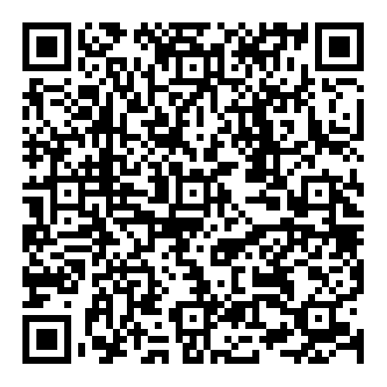
ACP Question Form & Resources
This is a link & QR code to a form to submit further ACP questions or request help with the sign-up for the ACP application process. The form also contains further ACP resources.
https://forms.gle/8tmgANCrpZEvBRdv5

